Slide 1

Establishing a Robust Pain Management Initiative Within Your Hospital
Welcome!
All lines are muted, so please ask your questions in Q&A
For technical issues, chat to the ‘Technical Support’ Panelist
Please actively participate in polling questions that pop up on the lower right-hand side of your screen
We will get started shortly!
Notes:
Karen will welcome participants as they join and play music.
At one minute before start time, Karen will summarize housekeeping:
Karen: “We have reached the top of the hour and will begin right after a couple housekeeping items:
To preserve the audio quality, we will keep all lines muted
Please enter your questions in the Q & A panel
You may also text with us through the chat panel if you have comments or need technical assistance
**We will have a couple polling questions—please answer so we can get to know you a little better and obtain your feedback through the evaluation at the end
A copy of the slides may be found on the Alliant Quality website, and a link there will be posted in chat in a moment.
And we have reached our start time of TIME, MODERATOR, the floor is yours...”
MODERATOR: Welcome and thank you for joining our presentation today entitled, “TITLE” We are glad you are with us today, and please know we are here to help and support you now and always.”

Slide 2
Establishing a Robust Pain Management Initiative Within Your Hospital
Presented by: Phyllis Hendry, MD, FAAP, FACEP
University of Florida College of Medicine
Brittany Johnson, PharmD, CPh
UF Health Jacksonville

Slide 3

















Collaborating to Support Your Quality Improvement Efforts

Slide 4


Featured Speakers
Phyllis Hendry, MD, FAAP, FACEP
Professor of Emergency Medicine and Pediatrics
University of Florida College of Medicine
Brittany Johnson, PharmD, CPh
Pain and Palliative Care Stewardship Pharmacist
UF Health Jacksonville

Slide 5
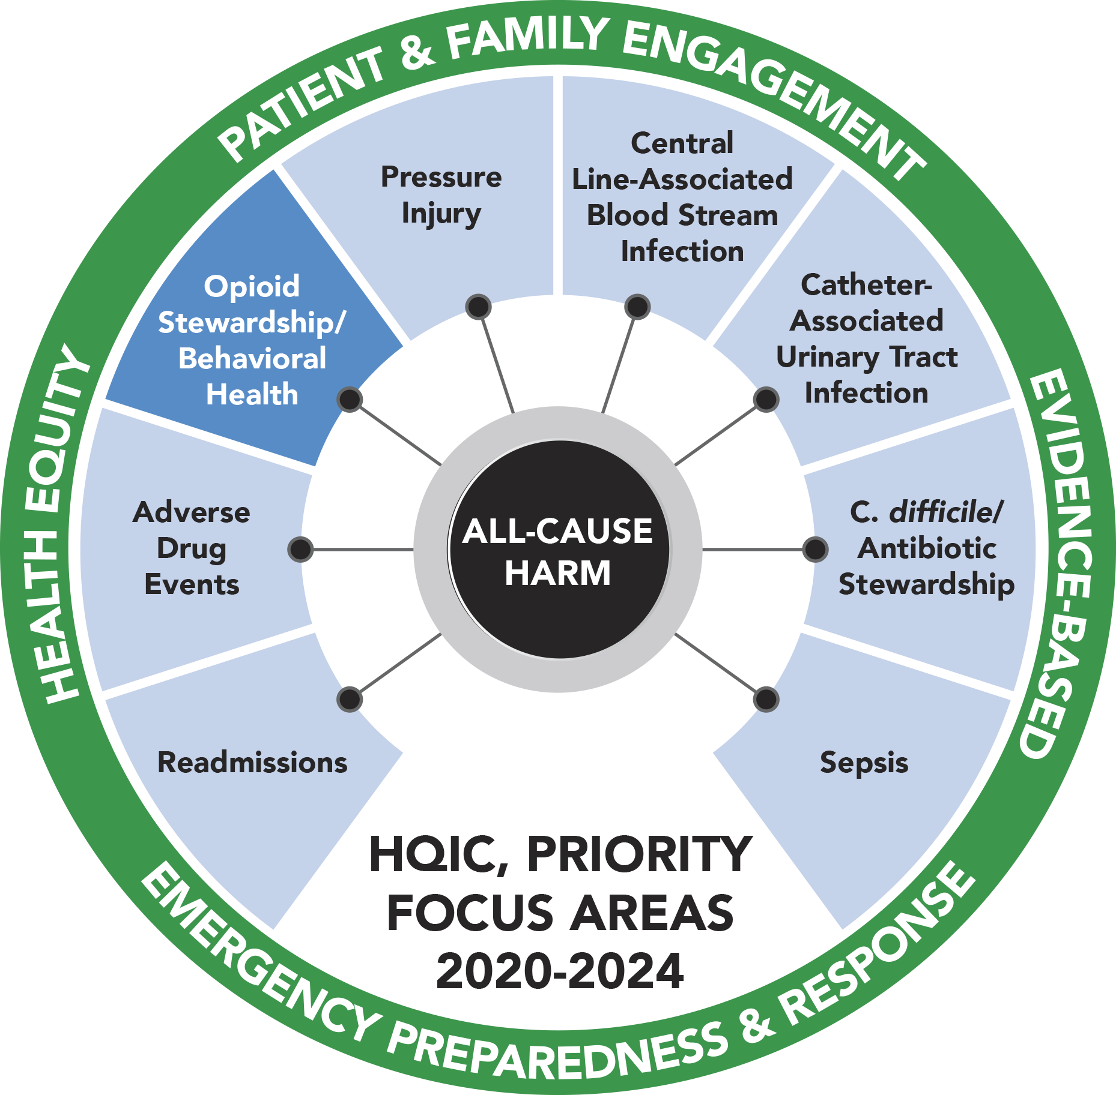
Learning Objectives
Learn Today:
  Identify key hospital staff to build an engaged network of pain management champions
  Describe PAMI patient education resources suitable for a variety of care settings
  Understand the key components to developing a patient discharge toolkit

Slide 6


7/27/2021
Advancing innovation and safety in pain education, patient care and research
HQIC LAN Presentation
Website: pami.emergency.med.jax.ufl.edu
Team Email: Pami@jax.ufl.edu
Notes:
Type your notes

Slide 7
Today’s Agenda
Introduction to the Pain Assessment and Management (PAMI)
Overview of PAMI free-access resources on pain management
Newly established PAMI sub-projects:
  PAMI pain coach/educator project overview
  PAMI ED-ALT project overview
  AI-PAMI project overview
Collaboration with UF Health Jacksonville through the Pain and Opioid Stewardship Taskforce
Q&A

Slide 8


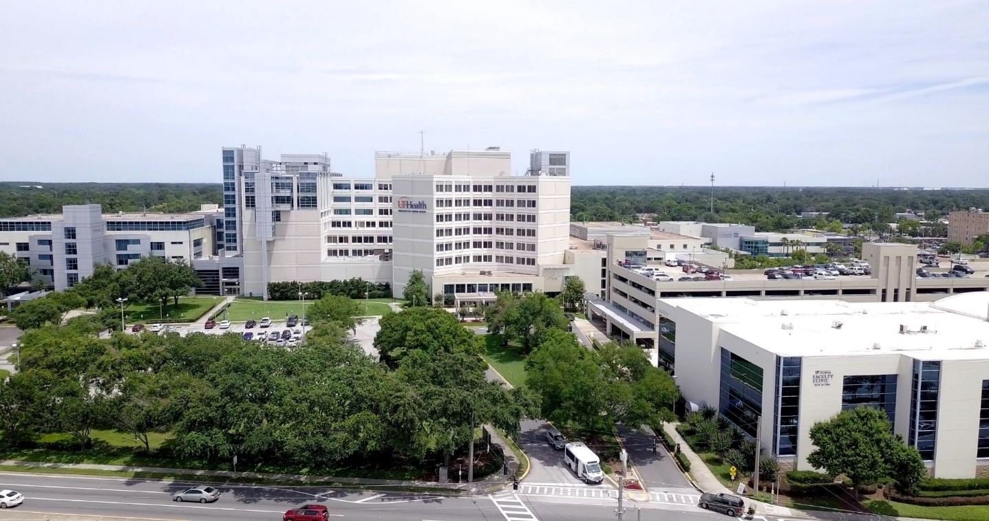
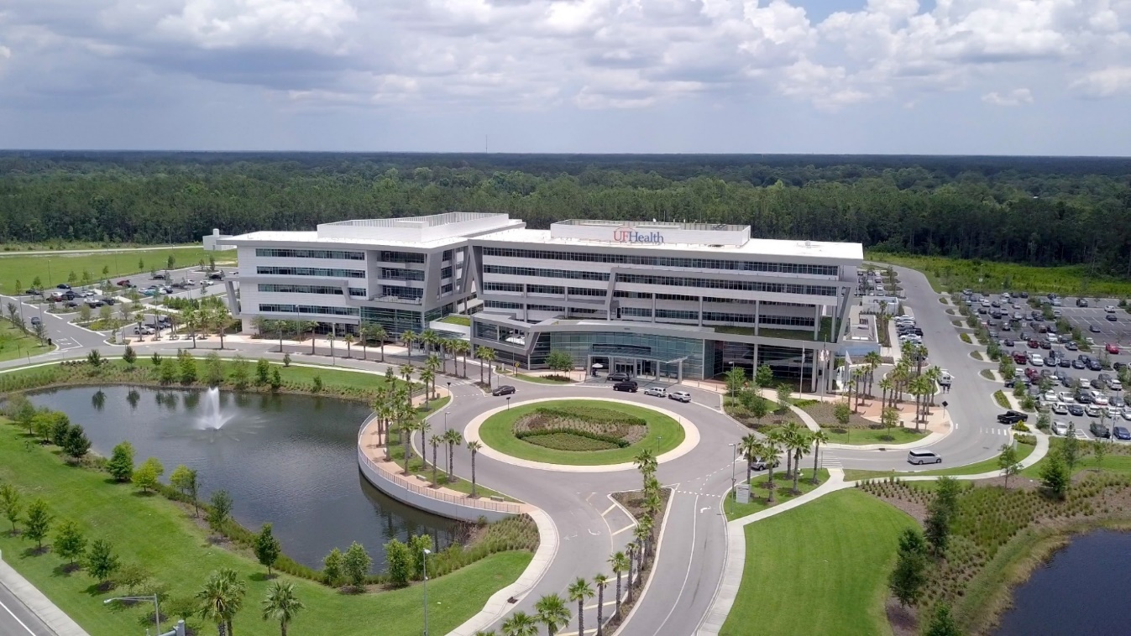



Our Setting and Background
Two very different sites
Notes:
2 campuses, Level I trauma center, safety net hospital, urban core,…………….. College of Medicine, Pharmacy, Nursing

Slide 9

PAMI Background
Established in 2014 by Drs. Phyllis Hendry and Sophia Sheikh
  Housed in the University of Florida College of Medicine Jacksonville Division of Emergency Medicine Research
  Initial intent was to improve pain management in Emergency Medicine
  Now includes a multidisciplinary team from emergency medicine, pharmacy, pain medicine, physical therapy, trauma, nursing, information technology, toxicology, UF Center for Data Solutions and more!

Slide 10



















Past and Present PAMI Stakeholders/Collaborators

Slide 11





Slide 12
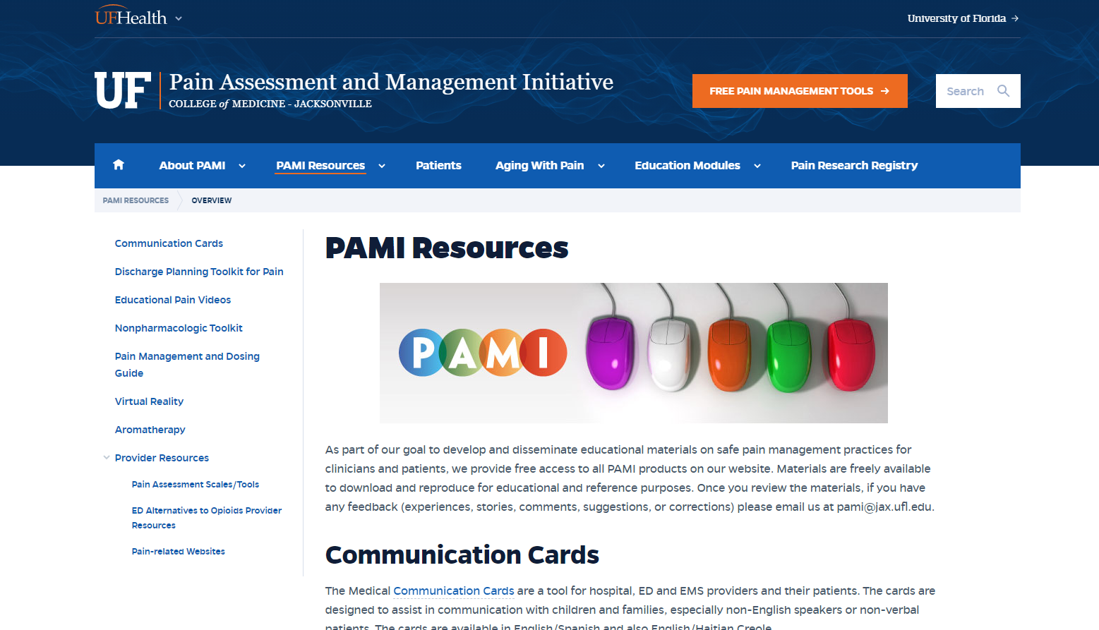
PAMI website: pami.emergency.med.jax.ufl.edu
Free resources for patients and providers
  After discharge patient education
  Educational videos and presentations
  Non-pharmacologic pain therapy resources
  Educational modules related to pain assessment & management (providers)
    CEUs phased out
    Presentations available

Slide 13
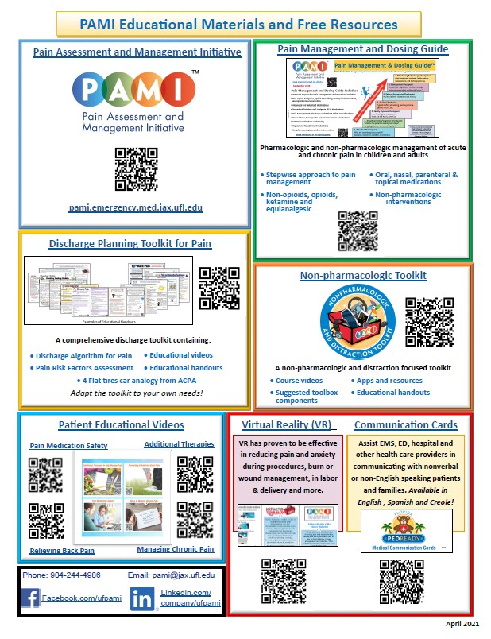
Overview of Resources
Pain Management and Dosing Guide
Discharge Planning Toolkit for Pain
Patient Educational Videos
Non-pharmacologic & Distraction Toolkit/Toolbox
Communication cards in Spanish and Creole with pain terms
pami.emergency.med.jax.ufl.edu/resources
Notes:
Type your notes

Slide 14
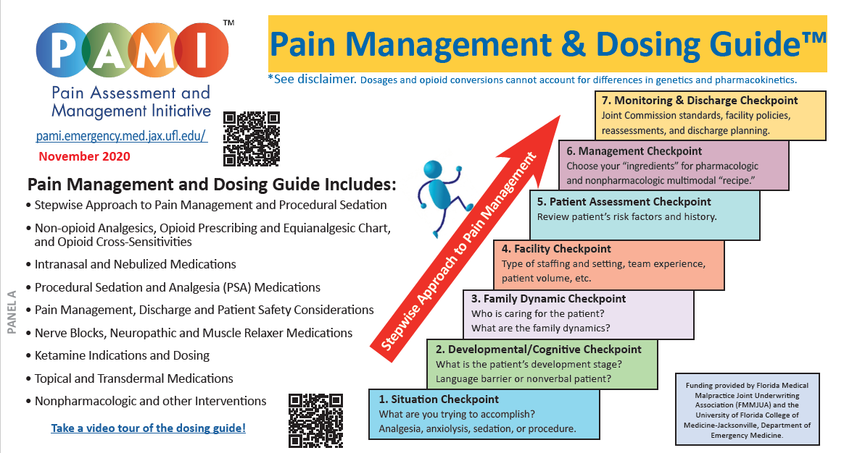
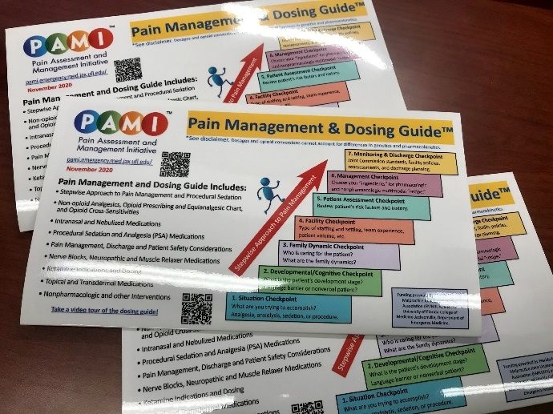
Pain Management & Dosing Guide
Stepwise Approach
Adult and pediatric dosing
Non-opioid Analgesics
Opioid Prescribing, Equianalgesic Chart and Cross-Sensitivities
Intranasal and Nebulized Medications
Procedural Sedation and Analgesia (PSA)
Discharge and Patient Safety Considerations
Nerve Blocks and Muscle Relaxers
Ketamine Indications and Dosing
Topical and Transdermal Medications
Non-pharmacologic Interventions
Always online: https://pami.emergency.med.jax.ufl.edu/resources/dosing-guide/

Slide 15
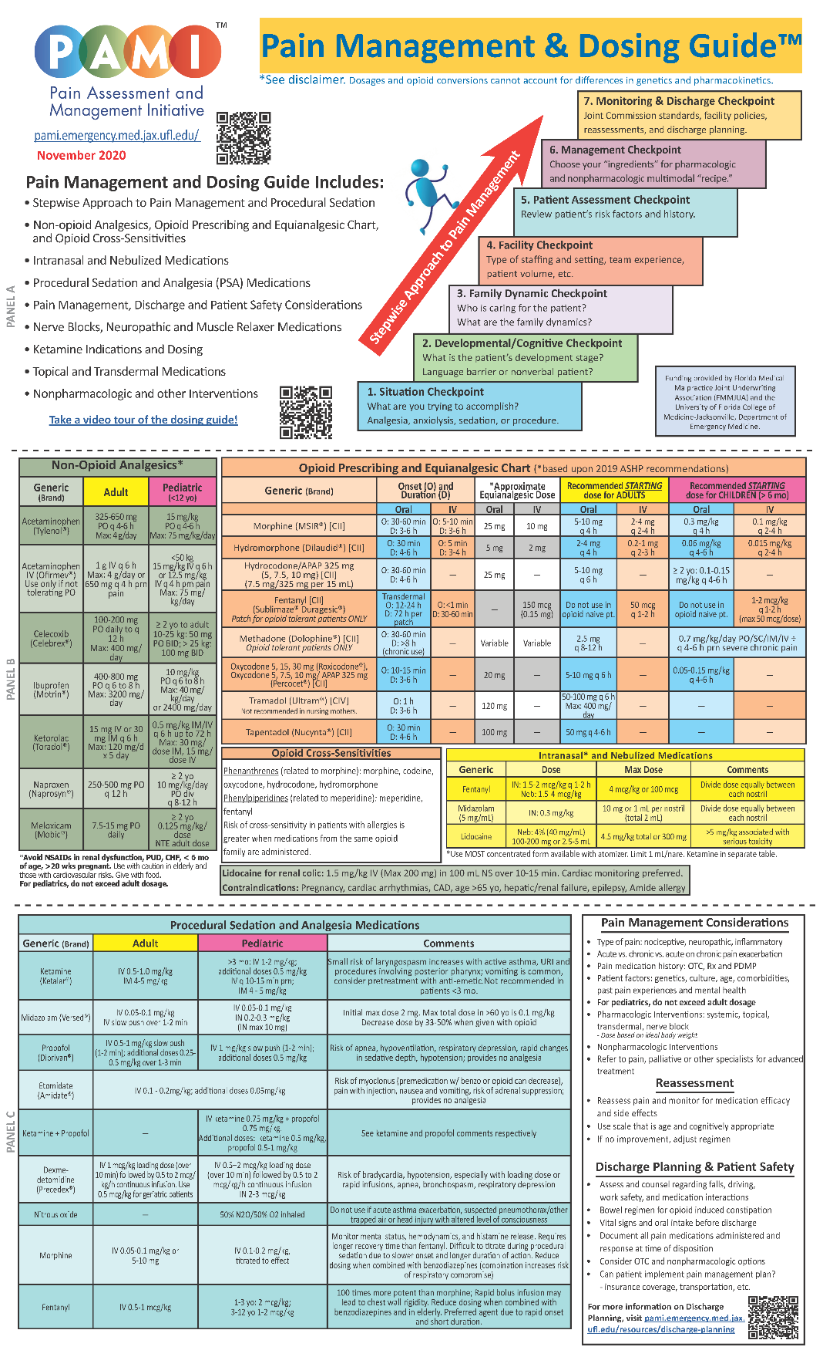
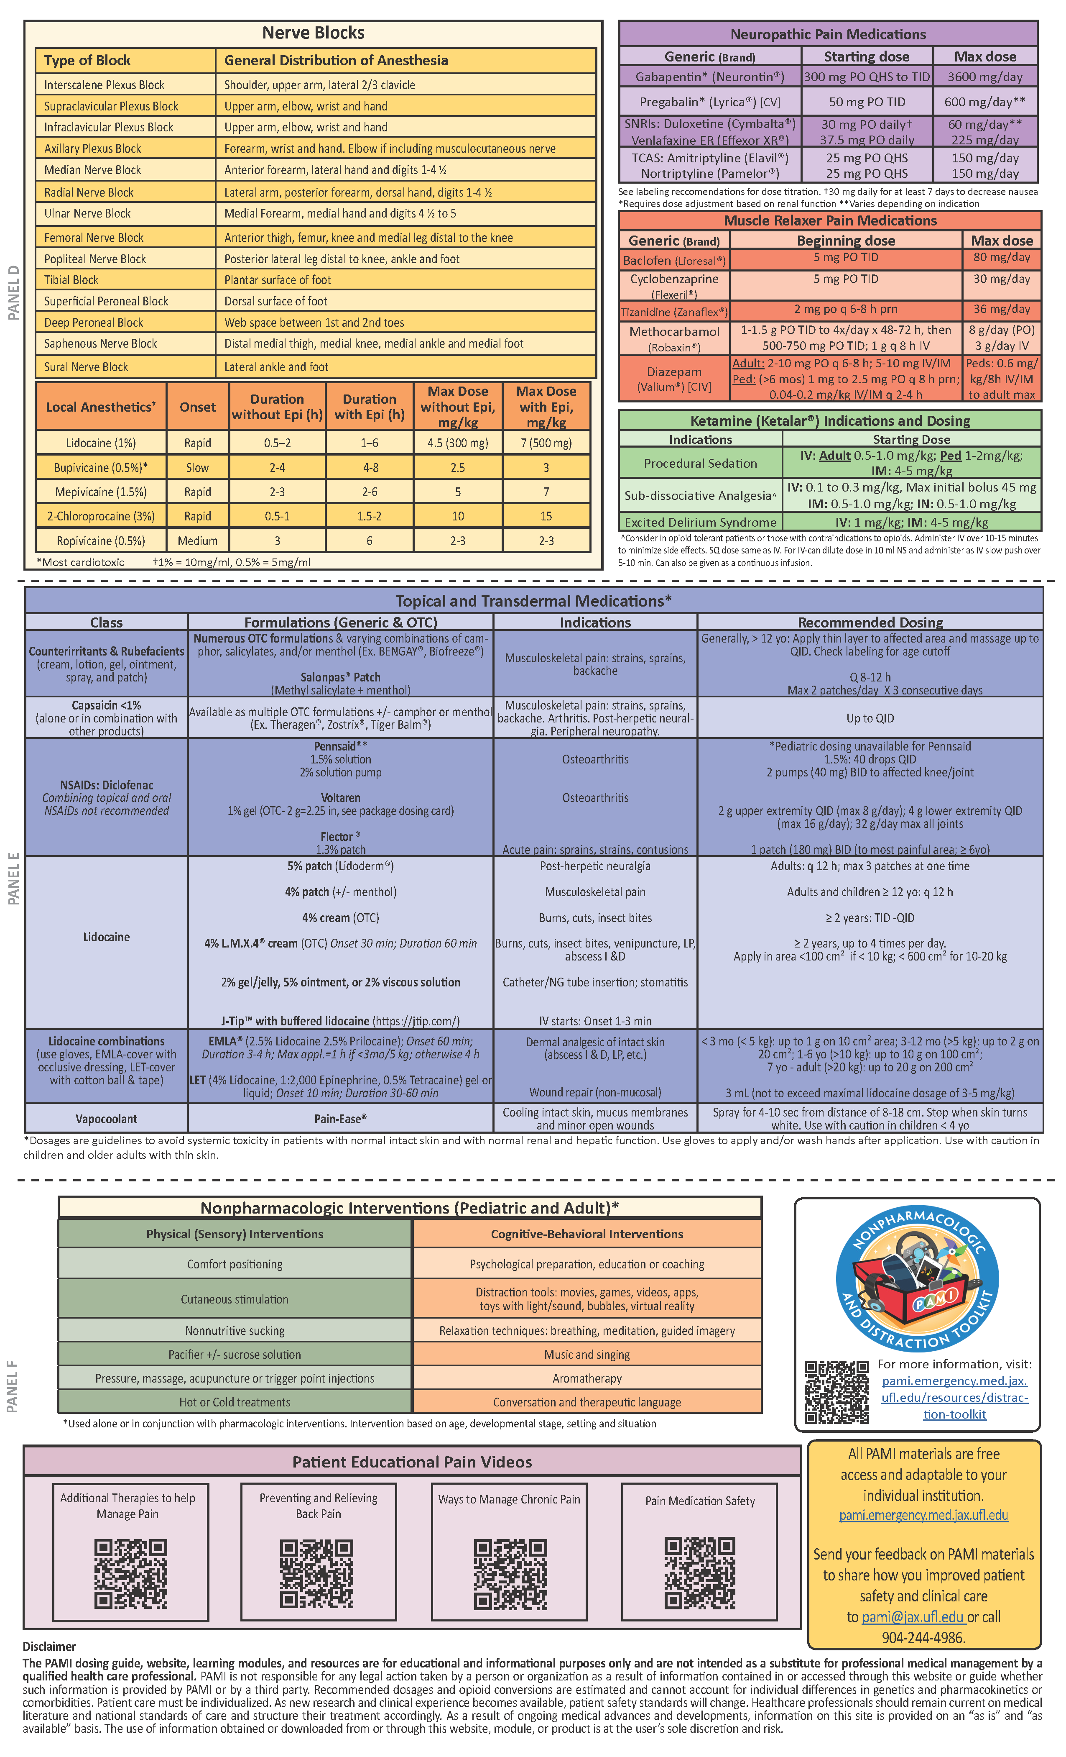
Dosing Guide
Free access to download but copyrighted by UF and PAMI
Prints best as legal size
Coordinated with UF Health Jacksonville hospital pain guide and recommendations from pharmacy guidelines and multidisciplinary team input
Contact pami@jax.ufl.edu for a trifold laminated copy!
Notes:
Safe starting point. Patients seen in ED or admitted that may be on meds not in your hospital’s pain policy

Slide 16
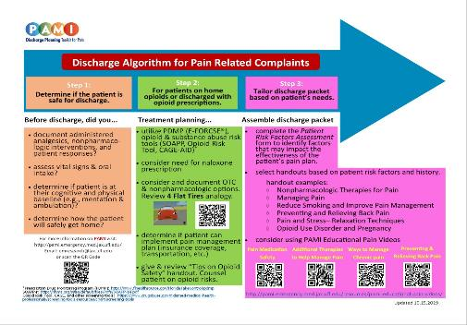
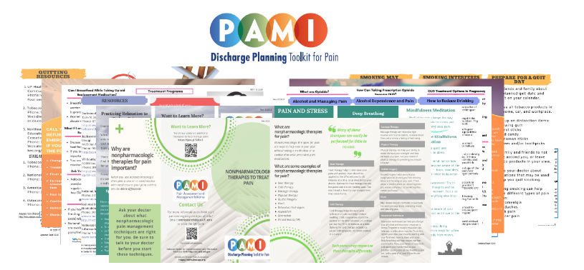
Discharge Planning Toolkit for Pain
  pami.emergency.med.jax.ufl.edu/resources/discharge-planning
Algorithm
  Safe practices
  Screening for opioid use disorders
  Identification of pain “risk factors”
Patient discharge brochures and videos
  Tips for managing pain at home without opioids
  17 brochures
  Can be inserted into hospital EMR as a dot phrase for providers to print upon patient discharge
Notes:
Originally requested by nursing, listen to your end users. What do they need to better treat pain effectively and safely?

Slide 17

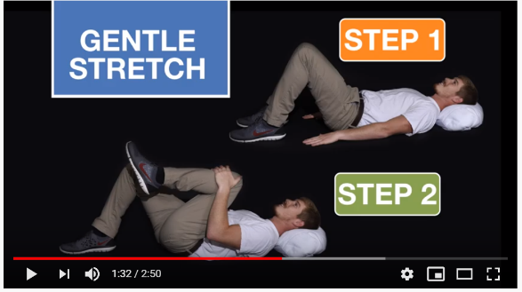
Patient Education Videos
PAMI patient-friendly pain education videos for use at discharge or any time for patients to access online:
Additional Therapies to Help Manage Pain: Non-pharmacologic and alternative therapies for pain management
Pain Medication Safety: Useful information and tips on taking pain medication safely
Preventing and Relieving Back Pain: Tips and exercises to manage back pain
Ways to Manage Chronic Pain: Helpful tips on managing chronic pain

Slide 18
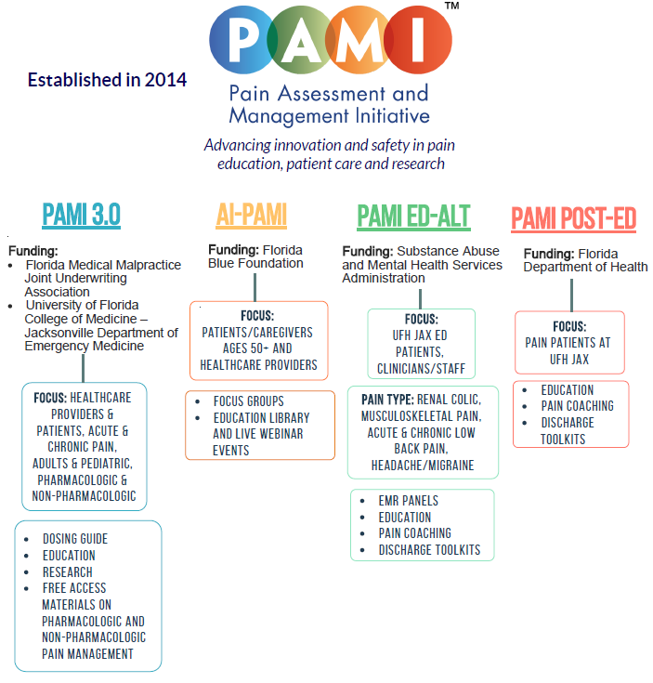

Slide 19

The Seed that Planted the Idea for a Pain Education and Coaching Service
Unanticipated opportunity for funding from a CDC Overdose Data to Action (OD2A) grant
  10 day turnaround
  During COVID
Contacted pain pharmacists, COP, nursing, physicians, PT, POST, etc.
  What is the one thing that would help you and your patients?
  “Time to educate, pain education, to learn more about nonpharmacologic integrative methods, access to integrative pain management for patients, ...”

Slide 20
Our Challenge
How to fill this education gap for patients and providers
  COVID restrictions
  Across multiple specialties
  Burn out, ↑stress, ↑need to churn and earn, nursing shortages, etc.
How to create a model pain educator or coach program that works across disciplines
  Name
  Structure
  Nonpharmacologic methods to highlight or suggest

Slide 21
The Impact of COVID-19 on Pain Management
CDC and our local data shows a rapid increase of overdoses and opioid related deaths since the beginning of the COVID-19 pandemic.
The COVID-19 pandemic resulted in a variety of new pain problems:
  Significant increase in inactivity due to lockdowns/quarantine resulting in deconditioning, impacting those relying PT, yoga or other programs as part of their pain management regimen.
  The onset or exacerbation of mental health conditions, including anxiety, depression, post-traumatic stress disorder, and alcohol dependence disorder
  Growing evidence that COVID-19 infection is associated with myalgia, referred pain, and widespread hyperalgesia (cytokine storm, limited rehabilitation after hospital discharge, etc.)

Slide 22
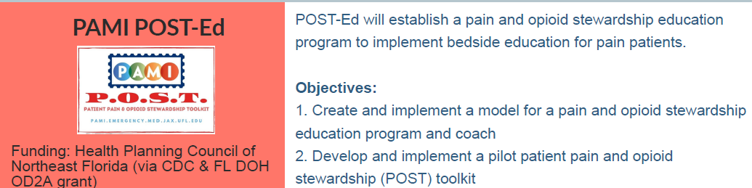

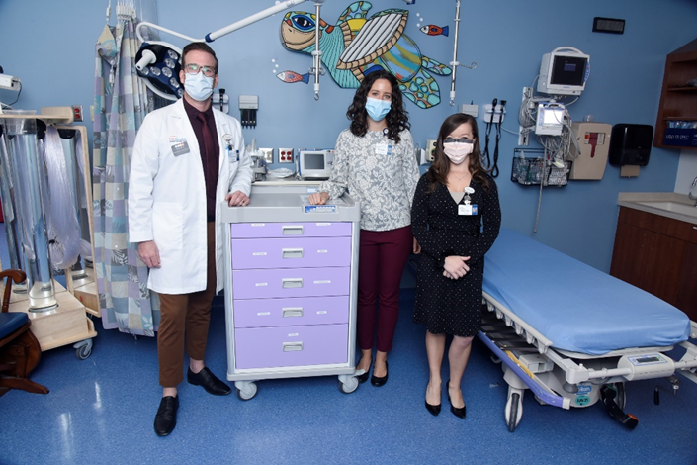

Slide 23
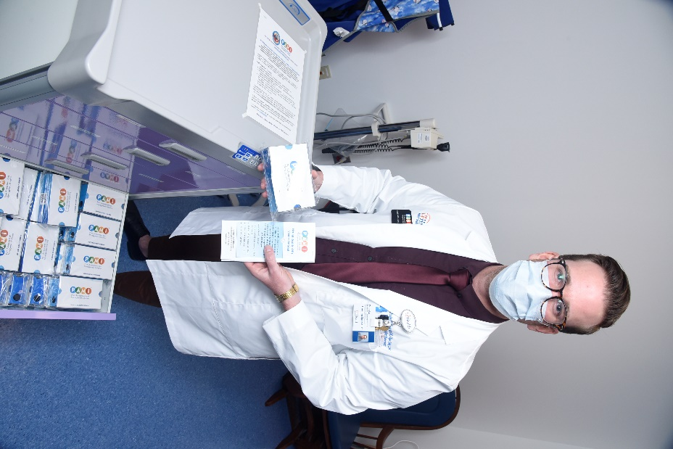
PAMI Pain Coach Pilot Project
Educates patients on non-pharmacologic and non-opioid or OTC analgesic options for pain management:
Basic review of pain neuroscience
Demonstrate integrative techniques with the patient and staff
Importance of prevention of acute to chronic pain transition
Options to improve pain and quality of life
Provide nonpharmacologic toolkit items and educational brochures
Review OTC oral and topical analgesic options
1st known ED pain coach in the US
Pain Coach – Doug Suffield, DACM, MAcOM, Dipl.OM, L.Ac
Providers access our pain coach through an EMR order
Dedicated pain coach/educator pager
Review of patient track board for appropriate patients

Slide 24

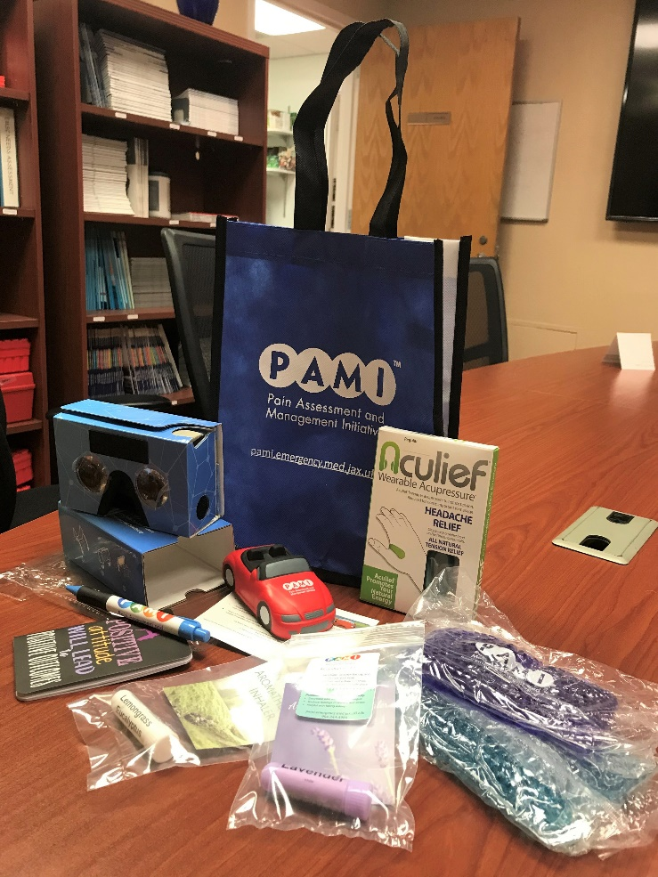
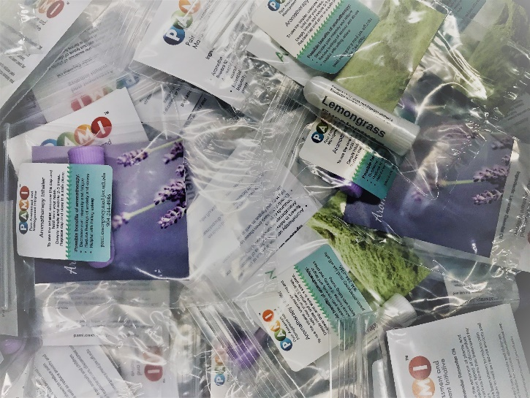
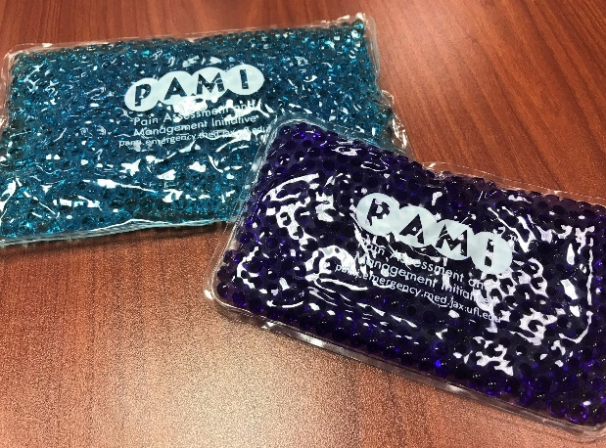
What’s in the toolkit?
Discharge toolkits for patients:
Car w/ 4 flat tires stress ball & analogy
Pain journals
Coloring sheets
Hand acupressure device for headache and tension pain
Hot/Cold gel packs
Aromatherapy inhalers
Virtual reality cardboard viewer
Video post card and applicable educational brochures
Extra pain scale badge buddies, dosing guides, pens, etc.

Slide 25

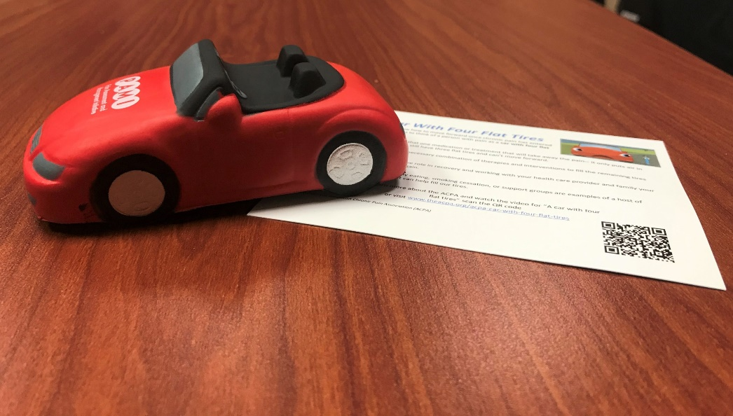
A Car with Four Flat Tires (ACPA)
http://www.theacpa.org/wp-content/uploads/2017/09/A-car-with-four-flat-tires_Transcript.pdf
Use of pain analogy with car stress ball and handout:
When you are in pain you are like a car with 4 flat tires. Medication only pumps up one of your tires. What will you use to pump up the other tires?
https://www.youtube.com/watch?v=QWcr9J3MLfo&feature=youtu.be
Notes:
Type your notes

Slide 26

Non-Pharmacologic Pain Management Analogy: Patients and Providers
Think of non-pharmacologic management as your “base coat” or “primer” before applying additional coats of analgesic or interventional treatments
With the right base coat foundation, you have a better chance of painting pain symptoms with a more tolerable and long-lasting new color.
Notes:
http://pemplaybook.org/podcast/pediatric-pain

Slide 27
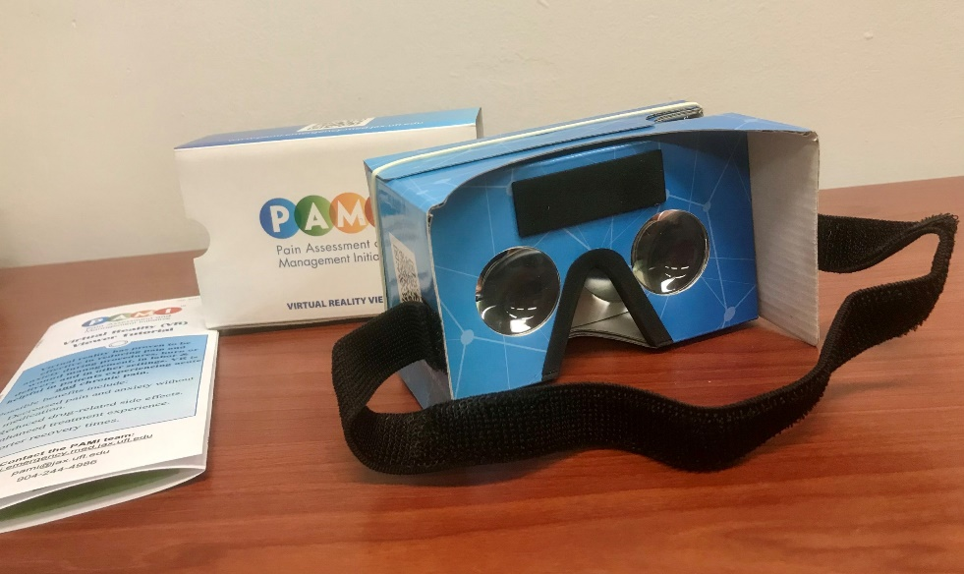
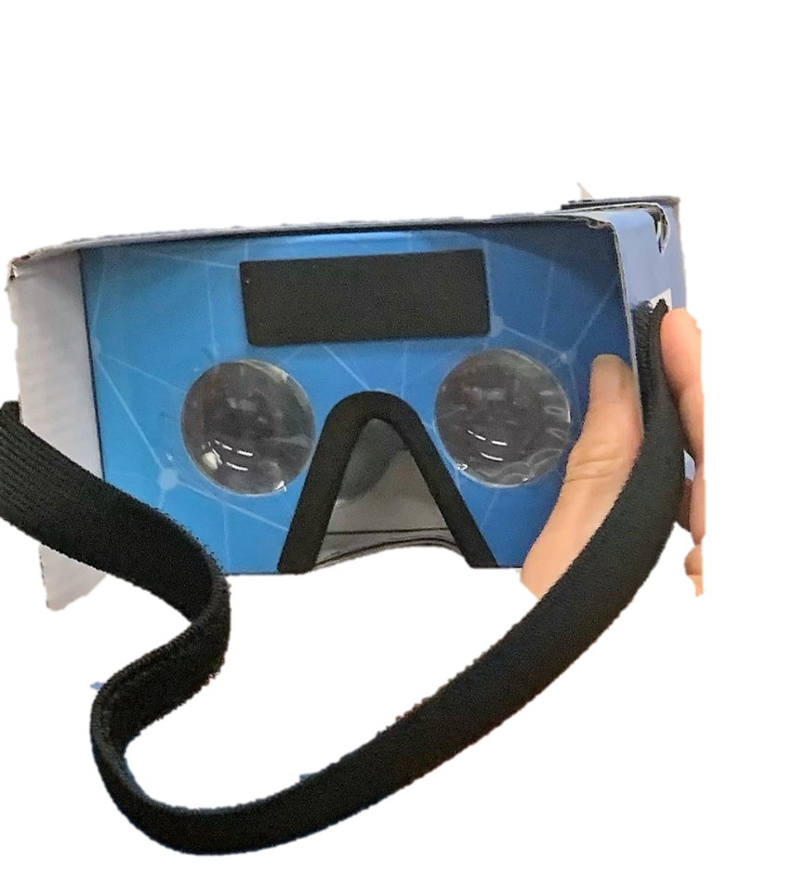

Virtual Reality
Virtual Reality may be helpful with the following:
Decreased pain and anxiety without medication
Reduced drug-related side effects
Enhanced treatment experience
Shorter recovery times
Increased patient satisfaction and coping
Use with caution in migraine headaches, concussion, etc.
Notes:
Type your notes

Slide 28
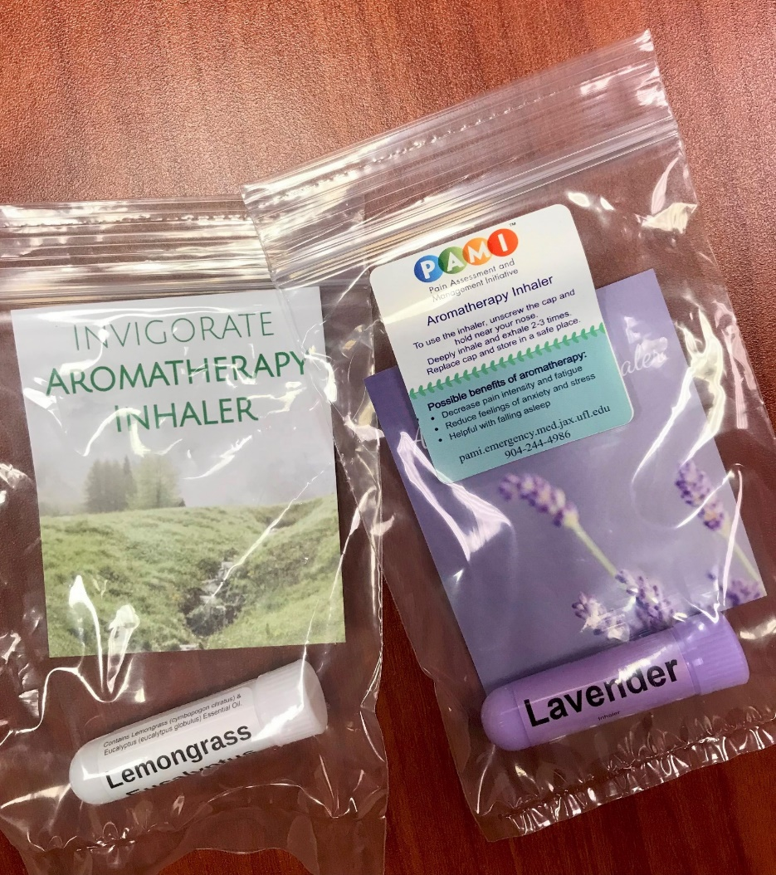
Aromatherapy
Aromatherapy is the use of essential oils from plants (flowers, herbs, or trees) as an integrative health approach. The essential oils are most often used by inhaling them or by applying a diluted form to the skin.
Studies have shown that aromatherapy helps:
Manage pain
Reduce anxiety
Calm stress
Boost immunity
Improve sleep quality
*for discharge use-no existing hospital policy
Notes:
Type your notes

Slide 29
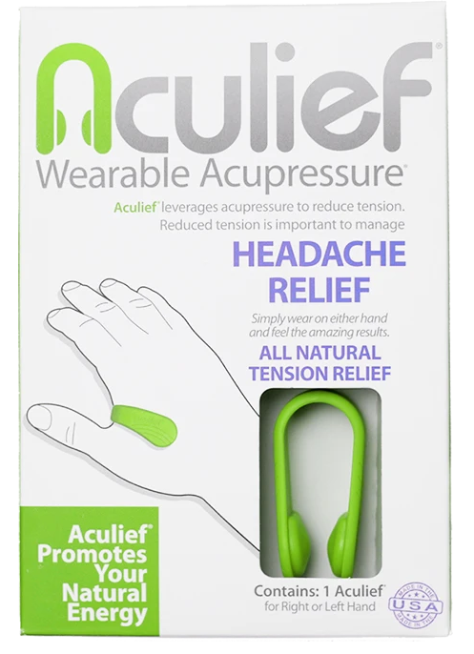
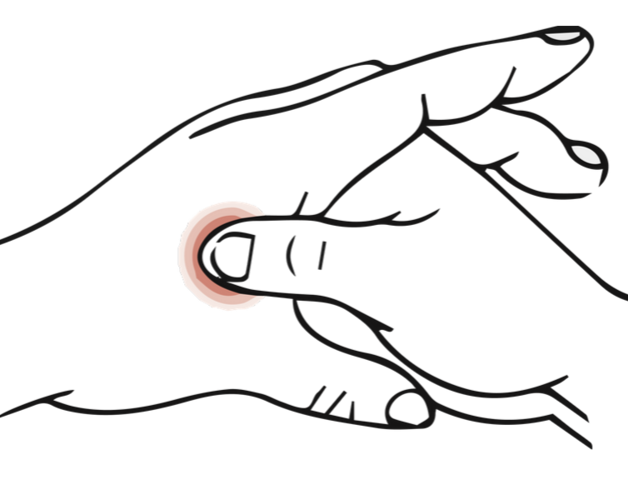
Hand Acupressure Device
Each device is individually boxed with printed instructions. We offer child, small and regular size options
The device uses the principles of acupoints and meridians from Traditional Chinese Medicine within the body, specifically targeting LI4
LI4 is known in TCM to be related to headache and tension relief
Item added after patient requests
Notes:
Acupressure is based on fundamental principle of activation of acupoints across the meridians. Activation of acupoints is facilitated by use of fingers or the simply available various hand-held acupressure devices. Acupressure is a type of acupuncture.
In acupressure, muscular tension is released by applying pressure with hand at specific acupoints or pressure of the thumbs on specific points or the application of pressure to acupoints is used to balance the flow of the physiological energy.

Slide 30
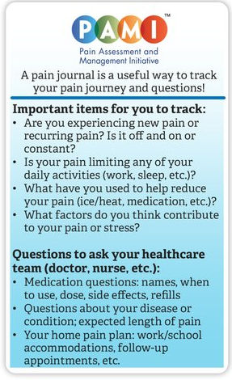

Pain Journals
Small pocket journals with an accompanying label to guide patients in journaling
Encourages patients to track symptoms, management, and daily activities
Prompts patient to write down questions for their healthcare team
Notes:
A pain journal (can be called a log, diary or notebook) is a simple tool to assist patients in keeping track of your pain flare-ups, intensity, treatment, appointments and emotions. It is very common for people to forget pain episodes or symptoms they want to share with their doctors. A pain journal can help your patients share a record of experiences including, pain location, intensity, duration, treatment, emotions and more.

Slide 31
Toolkit Compliance and Logistics:
Staying in Compliance with OIG Rules
Worked with university compliance and legal departments to ensure our toolkit process aligned with regulations
In compliance with the HHS Office of the Inspector General, our team negotiated prices and toolkit options to stay under the $15 per item/$75 annual value limit (section 1128A(a)(5) of the Social Security Act) for our toolkits
  https://oig.hhs.gov/fraud/docs/alertsandbulletins/OIG-Policy-Statement-Gifts-of-Nominal-Value.pdf
  https://oig.hhs.gov/fraud/docs/alertsandbulletins/SABGiftsandInducements.pdf
Toolkit inventory system and EMR allows usage reports and a means to monitor distribution
Notes:
Our team was considering the toolkits as educational materials and did not expect the compliance hurdles. We worked closely with our legal team to outline and approach that made them feel comfortable and keep things practical for our team. In the beginning, we were continuously reaching out directly to vendors for bulk order pricing to help make our toolkit robust and within the budget. Toolkits are tailored and it is not likely that a patient would get all items either, this further helps us stay under the limit. We use our bi-weekly restocking, cart patient toolkit log book and monthly reporting to monitor how toolkits and items are being distributed and to who. We have not encountered an issue in our first program year with the monetary limit or overuse.

Slide 32
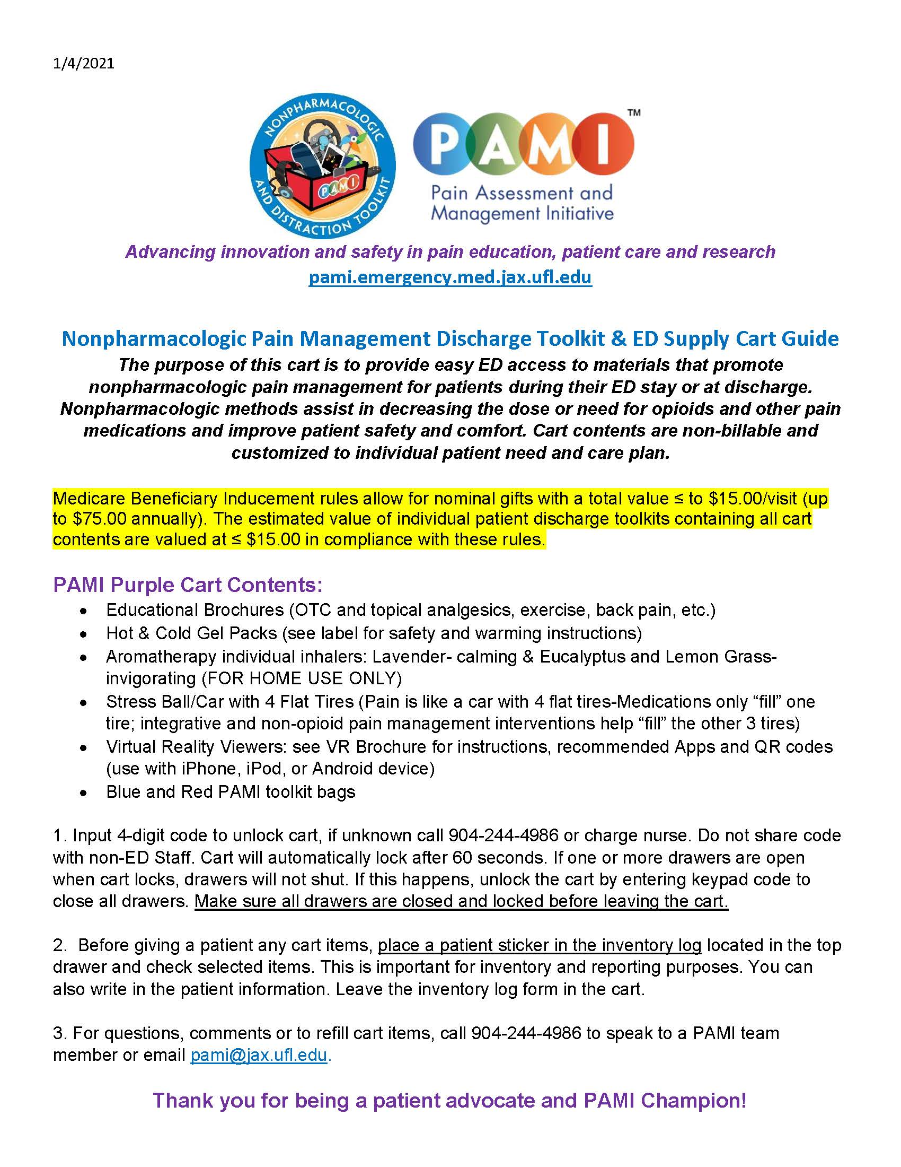

Slide 33
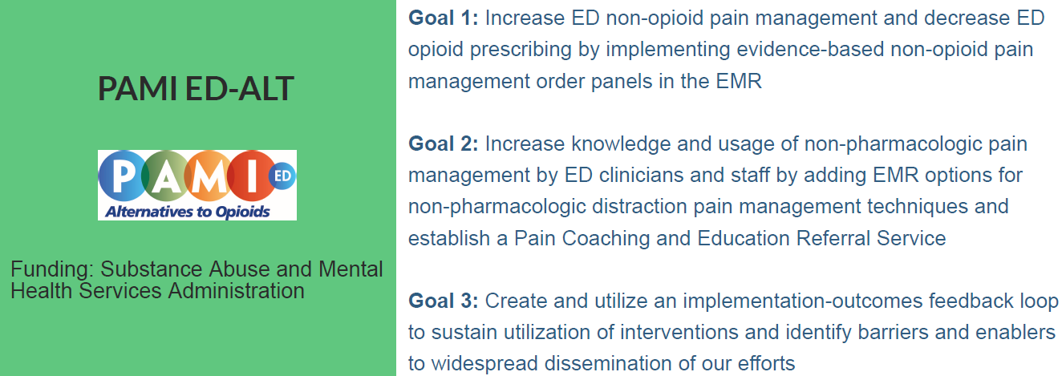
Four common painful ED conditions (renal colic, musculoskeletal pain, headache/migraine, and low back pain)
Order sets, discharge order sets, discharge toolkits, education
OTC medication starter pack discharge order
Champions: nursing, residents, PT, APPs, etc.

Slide 34
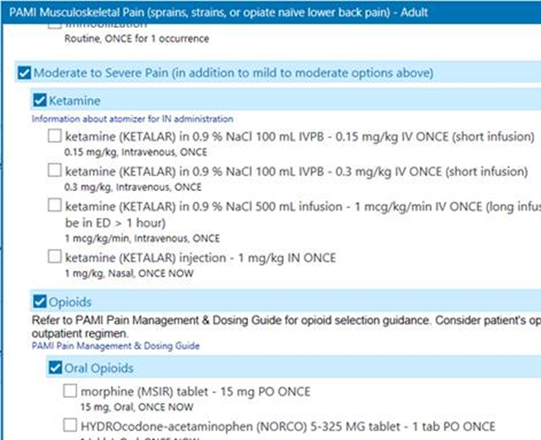
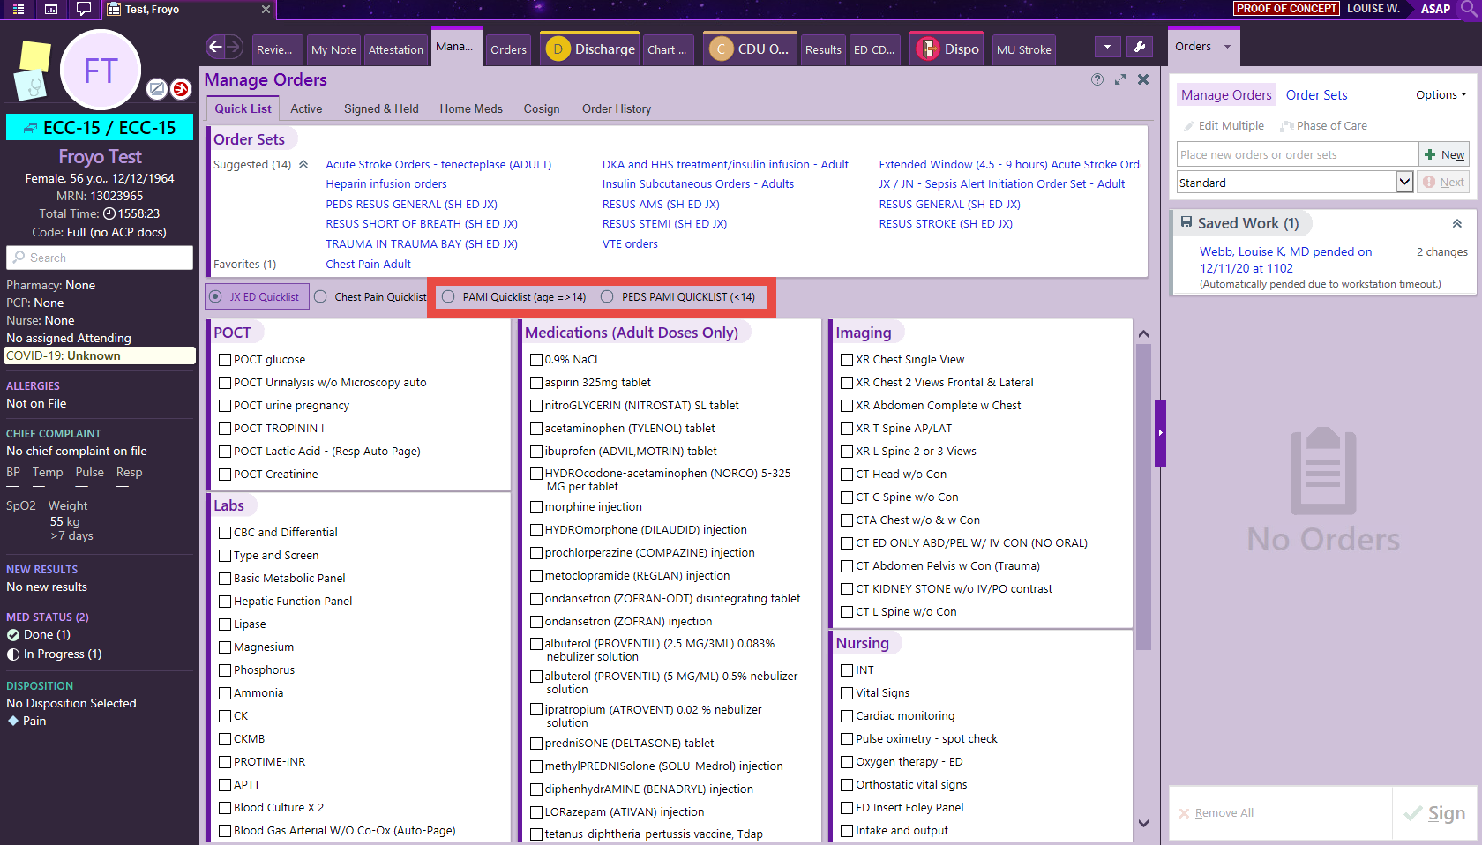
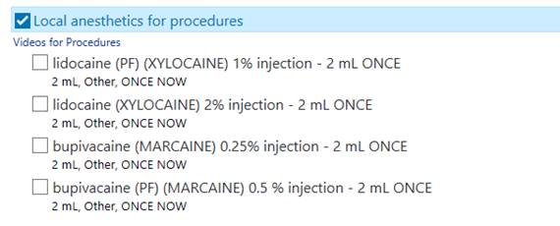
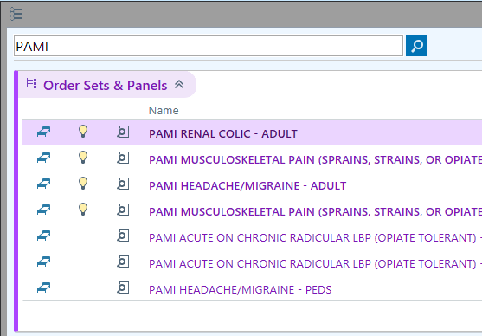
PAMI ED Order Panels
Pain order panels offer a one-stop shop for pain-related orders including pharmacologic and non-pharmacologic methods, acute and chronic pain with particular focus on renal colic, musculoskeletal pain, back pain, and headache/migraine.
Contain links to videos and information for procedures (e.g., ketamine administration, trigger point injections, nerve blocks, bursa injections)
Can be found EPIC ED Quick List or by searching for “PAMI”

Slide 35
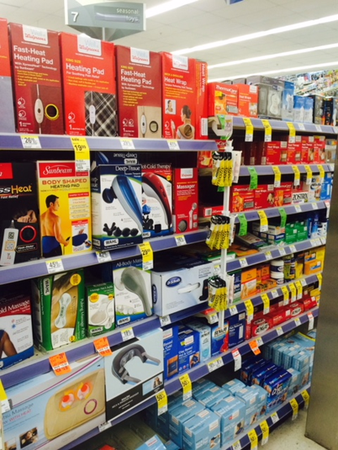
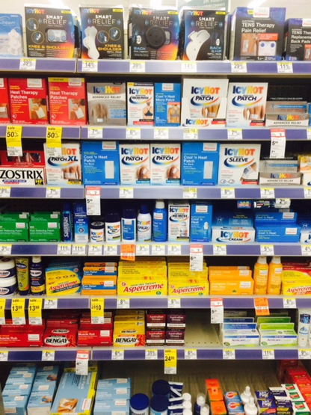
ED Patient OTC Discharge Order Panel
Acetaminophen (tablet and liquid options)
Ibuprofen
OTC 4% lidocaine patches
Diclofenac gel
For main downtown ED/TC
patients at time of discharge
  Unfunded
  New severe pain condition
  Limited mobility
  Other constraints limiting access to OTC analgesics.
Pharmacy aisles can be very overwhelming!

Slide 36
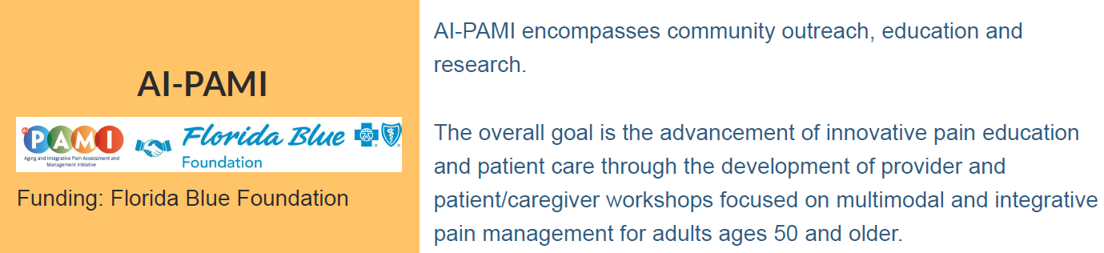

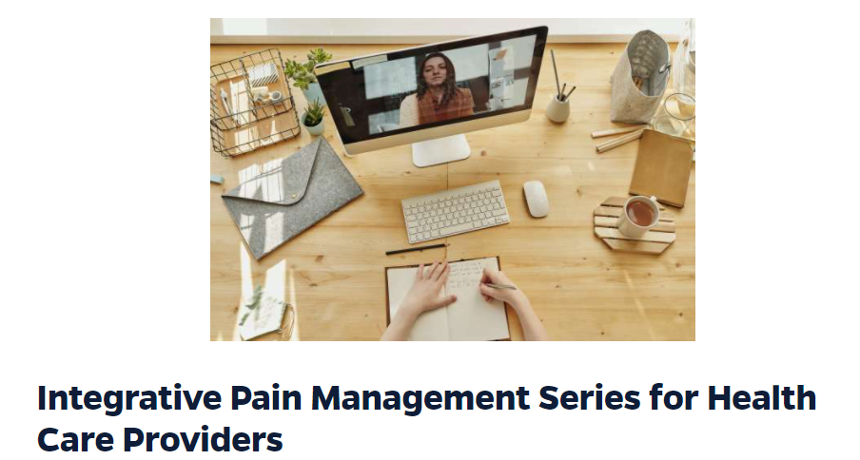
Integrative and non-opioid pain management education for Older Adults, Caregivers, and Providers

Slide 37
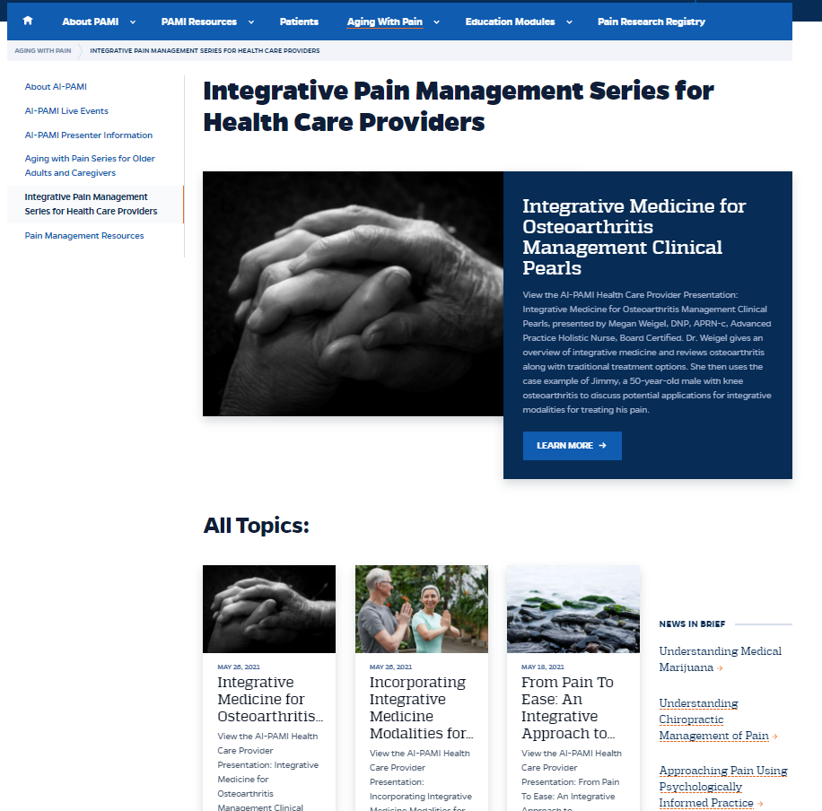
Visit the Aging With Pain web tab to view:
Upcoming live webinars
Recorded presentations you can access 24/7 on a variety of pain management topics

Slide 38
Pain and Opioid Stewardship Taskforce (POST)
Collect, analyze and act on clinical and non-clinical pain data
Increase patient satisfaction regarding analgesia
Maximize the use of evidence-based analgesic approaches in a multidisciplinary fashion
Reduce patient opioid exposure time and cumulative dosage in all clinical settings
Identify the patients most at risk of difficult-to-control pain, opioid-related side effects, or dependence and individualize care while minimizing risks of adverse opioid events
Notes:
Ball passed to Brittany

Slide 39
POST Committee Structure
Co-chairs
Anesthesia
Clinical
Non-Clinical
Pharmacy
System
CMO
Surgery
MD
ED
MD
Outpatient Medicine
MD
Hospital Medicine
CMO
Nursing
CNO
Acute Pain Service
Medical Director
Trauma Psychology
PhD
Therapeutic Policy
Drug Information
EPIC
Clinical Manager
North Campus
PharmD
Stewardship
Pain PharmD
Quality Improvement
CQO
Clinical Informatics
Director
Patient experience
Director
Outpatient pain
PharmD
Outcome Measurement
Case Management
Director
Secretary
Pain PharmD
Notes:
Cool!

Slide 40
POST Initiatives
2017
2018
2019
2020
2021
Pain and Palliative Care Stewardship Pharmacist
Joint Commission Gap Analysis
Analgesic Metric Development
IV Opioids Removed Admission Order-sets
IV to PO Pharmacist Auto Substitution Implemented
POST Committee Formation
Removal of Benzodiazepines from Order-sets
Patient Opioid Discharge Education Documentation
House Bill 21 Controlled Substances Legislation
Mandatory Provider Pain Education
Nursing Pain Committee
Pharmacist Long Acting Opioid Verification on Admission
Naloxone Outpatient Pharmacist Standing Order
IV Acetaminophen Non-Formulary Criteria for Use
Florida Society of Health System Pharmacist
“Best Practice” Award
Ketamine Infusions for Pain Pilot on Progressive Units
House Bill 451
Non-opioid Alternatives Legislation
Opioid Calculator EPIC© Build
Implementation of Outpatient Naloxone BPA
House Bill 831 Electronic Prescribing Implement
Nursing and Provider Pain Scale Education
Perioperative Pain Management for Patients with Opioid Use Disorder
Expanded Buprenorphine Formulary Options
Perioperative Management of Pain in Patients with Obstructive Sleep Apnea Guidance
A-02-005 Functional Pain Scale (DVPRS)
Developed Intrathecal Pump Policy
Expanded Abuse Deterrent Long Acting Formulary Options

Slide 41
POST Outcomes
Reduction of IV opioid utilization
Decreased inappropriate IV acetaminophen utilization
Reduction of average pain scores
Reduction of benzodiazepine utilization
Naloxone outpatient prescriptions
Regulatory compliance
Increased multimodal analgesic use
Notes:
Needs jazzing up?

Slide 42
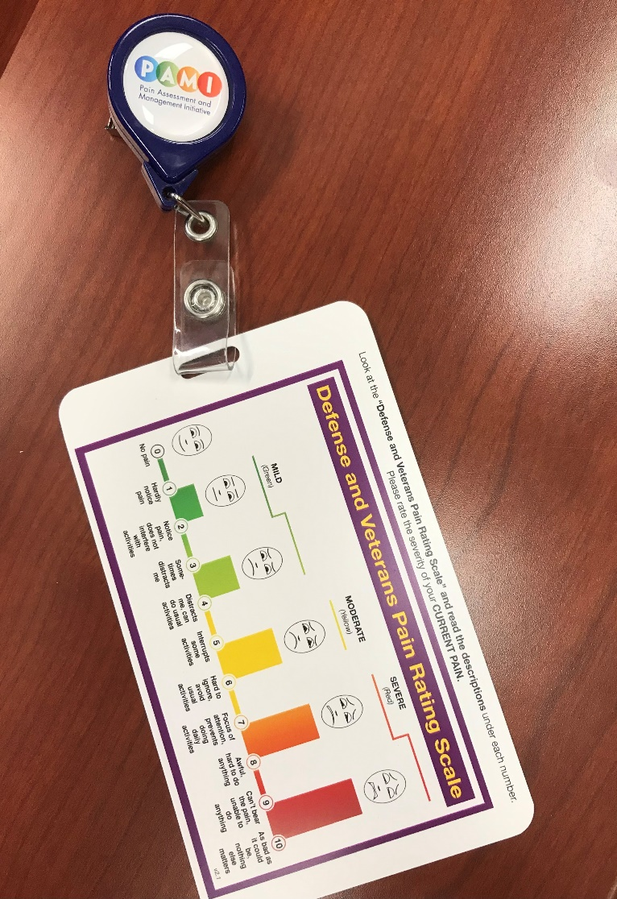
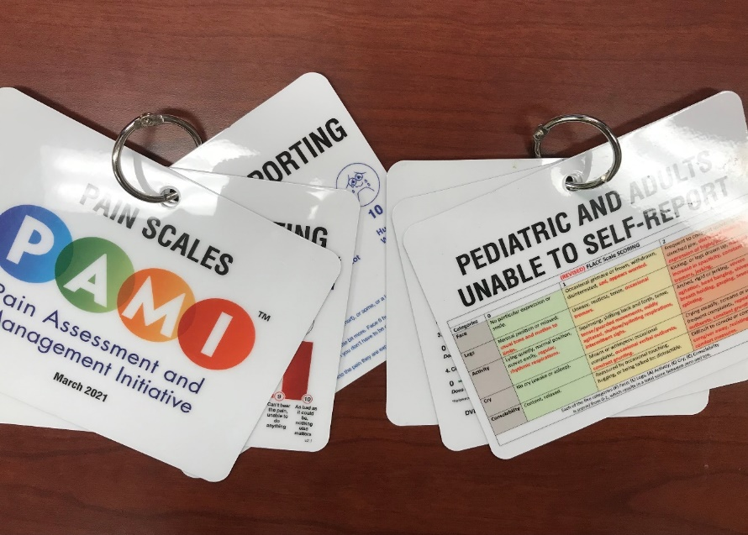
Pain Scale Hospital Policy Update
2021: New institution-wide nursing pain policy changing from NRS to DVPRS
PAMI collaborated to provide badge buddies and pain scale cards to nursing units with all scales

Slide 43
PAMI Impact and Dissemination
PAMI products used across the U.S. and other countries
Multidisciplinary
Modified for other universities and organizations
Cited in text books and other publications
Aids hospitals in meeting Joint Commission pain-related standards
Notes:
Back to Phyllis

Slide 44
Key Lessons Learned
Need for multidisciplinary weekly rounds
Champions and resource review
Providers enthusiastic to have new tools
Inventory system
Finding vendors

Slide 45
Questions?

Slide 46


Slide 47
Resources
pami.emergency.med.jax.ufl.edu
Do's and Don'ts of Pain Medicine
Comfort Menu
Naloxone Tip Sheet
PEG Scale
Drug Disposal: Drug Take Back Locations
Medication Risk Alert: Opioids & Benzodiazepines
Notes:
https://www.cdc.gov/coronavirus/2019-ncov/downloads/HCW_Checklist_508.pdf

Slide 48


Key Takeaways
Learn Today:
  Identify key hospital staff to build an engaged network of pain management champions
  Describe PAMI patient education resources suitable for a variety of care settings
  Understand the key components to developing a patient discharge toolkit
Use Tomorrow:
  Leverage PAMI resources to enhance pain management team and patient care resources
How will this change what you do? Please tell us in the poll…
Notes:
We expect by the end of this presentation we expect that you will SUMMARIZE Objectives

Slide 49




Contact Us
Alliant HQIC Team
Karen Holtz,
MT (ASCP), MS, CPHQ
Alliant Quality
Karen.holtz@allianthealth.org
View our Website
IPRO HQIC Team
Rebecca Van Vorst, MSPH, CPHQ
HQIC Project Manager
RVanVorst@ipro.org
View our Website
Telligen HQIC Team
Meg Nugent,
MHA, RN
HQIC Program Manager
mnugent@telligen.com
View our Website

Slide 50

Questions?
Email us at HospitalQuality@AlliantQuality.org or call us 678-527-3681
Notes:
Donna will take Questions. Karen will moderate chat
Polling question opens

Slide 51



HQIC Goals
Behavioral Health
Outcomes & Opioid Misuse
Promote opioid best practices
Decrease high dose opioid prescribing and opioid adverse events in all settings
Increase access to behavioral health services
Reduce risky medication combinations
Reduce adverse drug events
Reduce C. diff in all settings
Patient Safety
Convene community coalitions
Identify and promote optical care for super utilizers
Reduce community-based adverse drug events
Quality of Care Transitions
Notes:
Our presentation today has covered aspects of the five CMS aims.

Slide 52
Upcoming Events
August 24, 2021 1:00 p.m. EST
Sepsis
Hosted by IPRO HQIC
Details forthcoming
Notes:
MODERATOR: We hope to see you at some of our upcoming events. Please take a moment and let us know how we did by completing the evaluation that is in the polling window on your screen.
Chat: Register at: https://alliantquality.org/learning-and-action-webinars/

Slide 53
Thank you for joining us today!
This material was prepared by Alliant Health Solutions, a Hospital Quality Improvement Contractor (HQIC) under contract with the Centers for Medicare & Medicaid Services (CMS), an agency of the U.S. Department of Health and Human Services (HHS). Views expressed in this material do not necessarily reflect the official views or policy of CMS or HHS, and any reference to a specific product or entity herein does not constitute endorsement of that product or entity by CMS or HHS. Publication No. AHSHQIC-TO3H-21-894-07/22/21

